Slide 1
Machine Learning - Supervised Learning
Carlos Siches
Sep 2016

Slide 2



How to get started ?
Open Data science platform
Big Data
Machine Learning
Data Visualization
Analytics
Data Mining
Open source library
Machine Learning
Data Mining
Object-oriented programming language
Current version 3.5
Expert people => Version 2.7

Slide 3

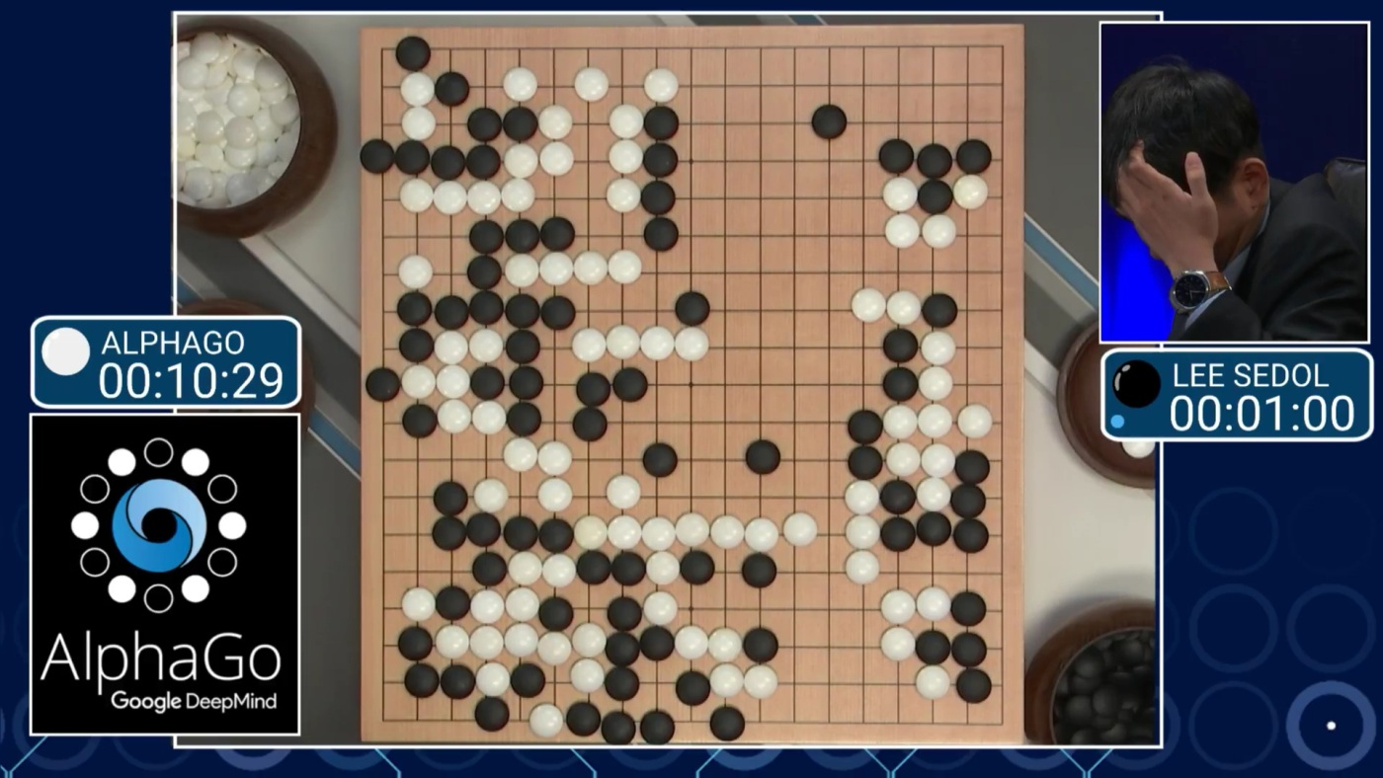
Machine learning – General concepts
Subfield of AI
1 Algorithm => resolve many problems
Alpha GO
Google DeepMind
2015 => Only play Atari games
2016 => Participated in World Tournament about table game called GO
Source: http://www.elperiodico.com/es/noticias/sociedad/alphago-aprender-estrategia-videojuegos-4905849

Slide 4
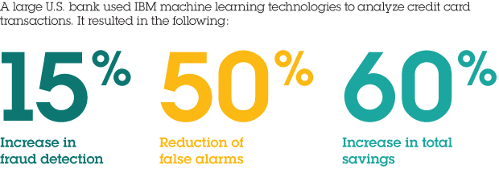

Machine learning – Cases
Credit card fraud detection
Fraud Insurance
Face and Voice recognition
Medical Diagnosis
Product recommendation
Stock Trending
……
Subfield of AI
1 Algorithm => resolve many problems
Reduce in 30% Cost of Car insurance
Detected criminal group dedicated to cheat insurance enterprises

Slide 5
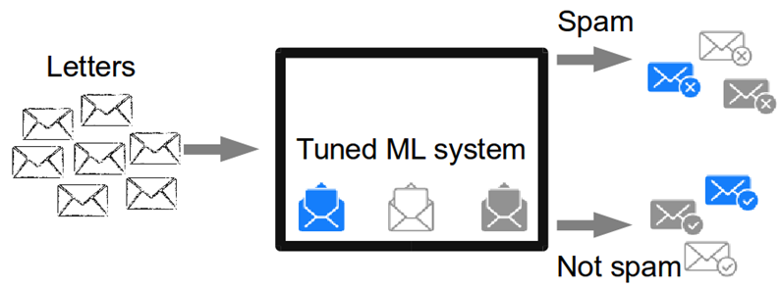






Machine learning – Cases
Ticket Request
BI member
Subfield of AI
1 Algorithm => resolve many problems
Hard-code rules
Machine Learning

Slide 6
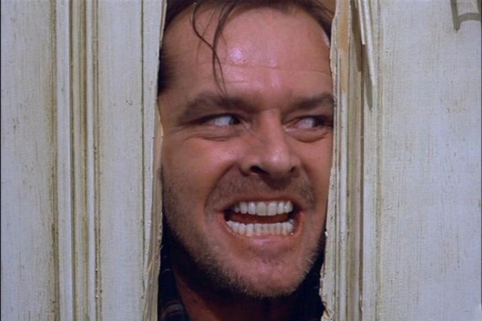
Machine learning – Cases
Ticket Request
BI member
Hard-coded rules
If Ticket contains “Ticketing Agg” => Assign Carlos S.
If Ticket contains “Tkt Agg” => Assign Carlos S.
If Ticket contains “BMI” => Assign Jim L.
If Ticket contains “BMI” and “CMDB” And (“Delete” or “Remove” or “Rid Of” ) => Assing Davis C.
Subfield of AI
1 Algorithm => resolve many problems

Slide 7
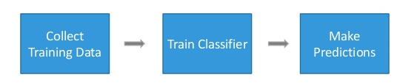
Machine learning – Classifier
Takes some data as input
Assign a label to it.
Supervised Learning => The technique to write a classifier automatically
It Begins with examples which we want to solve
Ticket Request
BI member

Slide 8
Supervised Learning – Training Data / Testing Data
Whole tables is our training Data
All examples => We want to classify to learn from
Lot of examples => Create a better classifier
Choose good features.

Slide 9
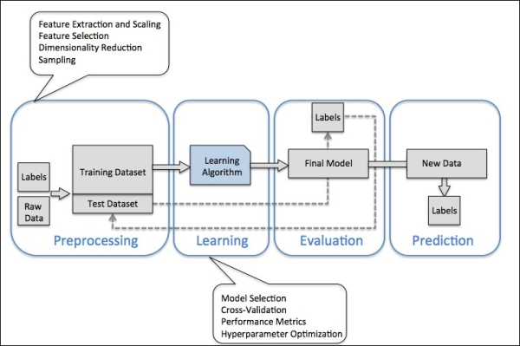
Supervised Learning – Work flow

